Slide 1
Optimal Implementation of Quantum Circuits for Core Operations in BIKE
Yujin Yang, Kyungbae Jang, Yujin Oh, Sejin Lim, and Hwajeong Seo

Slide 2
Contents
Introduction
Related Works
Quantum Implementation of BIKE
Evaluation and Conclusion

Slide 3
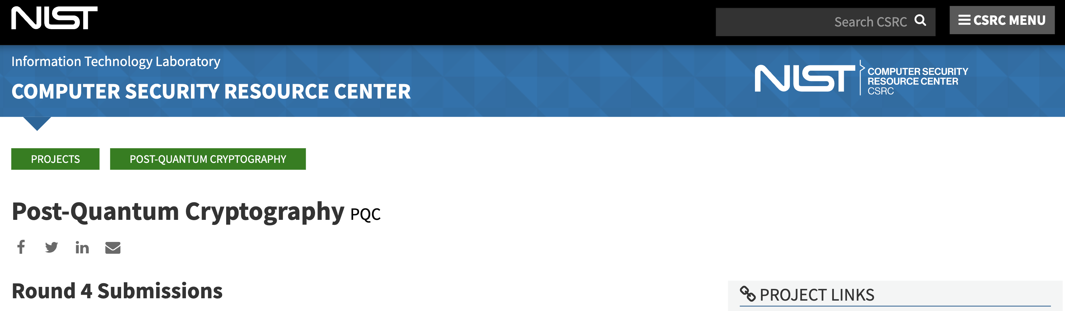
1. Introduction
The NIST is currently conducting a competition on Post-Quantum Cryptography (PQC).
For the quantum cryptanalysis, target cipher must be implemented on quantum circuit.
We implement quantum circuits of core operations for BIKE, which is the alternate algorithm in PQC competition Round 4.

Slide 4

2. BIKE
Key Encapsulation Mechanism (KEM) based on Quasi Cyclic Moderate density Parity Check (QC-MDPC) code.
Rotated values of a row become the next rows.
$$h=\left(\begin{matrix}h_{0} & h_{1} & ⋯ & h_{r−2} & h_{r−1} \\ h_{r−1} & h_{0} & ⋯ & h_{r−3} & h_{r−2} \\ ⋮ & h_{r−1} & h_{0} & ⋱ & ⋮ \\ h_{2} & ⋱ & ⋱ & ⋱ & h_{1} \\ h_{1} & h_{2} & ⋯ & h_{r−1} & h_{0}\end{matrix}\right)$$
By storing only a single row, it is possible to reduce
the key size since the entire matrix is not stored.

Slide 5
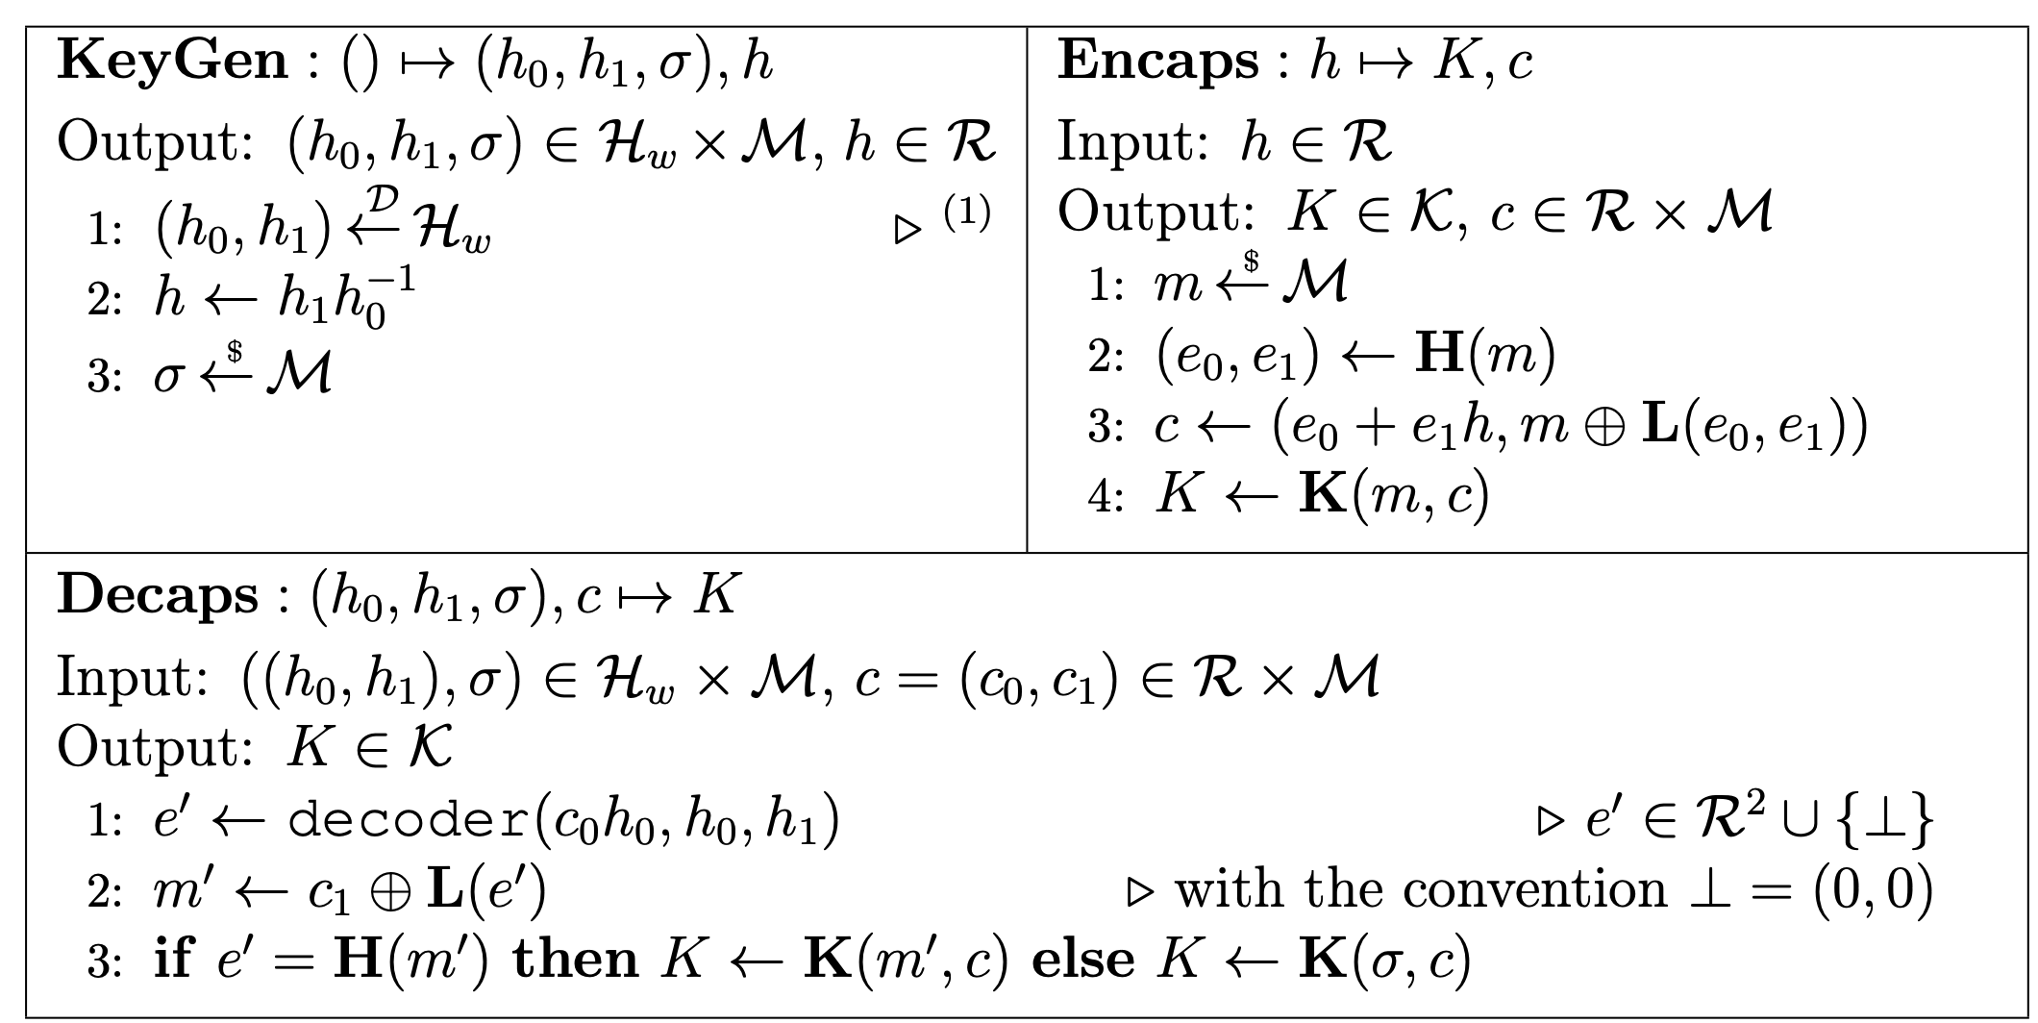
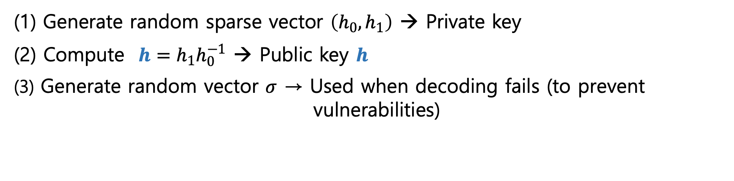
2. BIKE
1) Key Gen
Generate random sparse vector $\left(h_{0}, h_{1}\right)$ → Private key
(2) Compute $h=h_{1}h_{0}^{−1}$ → Public key $h$
(3) Generate random vector $σ$ → Used when decoding fails (to prevent vulnerabilities)
Notes:
시그마

Slide 6
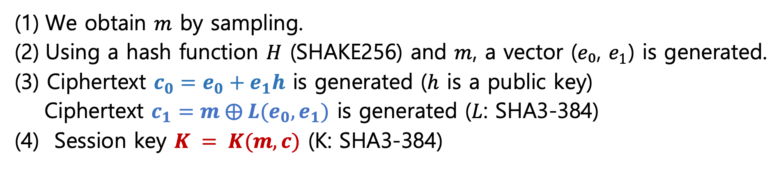
2. BIKE
2) Encapsulation
We obtain $m$ by sampling.
Using a hash function $H$ (SHAKE256) and $m$, a vector (𝑒₀, $e_{1}$) is generated.
(3) Ciphertext $c_{0}=e_{0}+e_{1}h$ is generated ($h$ is a public key)
Ciphertext $c_{1}=m ⨁ {L(e_{0},e}_{1})$ is generated ($L$: SHA3-384)
(4) Session key $K = K(m, c)$ (K: SHA3-384)

Slide 7
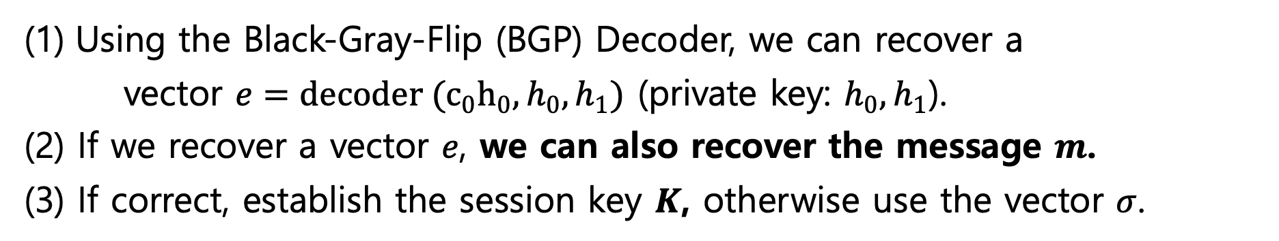
2. BIKE
3) Decapsulation
Using the Black-Gray-Flip (BGP) Decoder, we can recover a
vector $e=decoder (c_{0}h_{0}, h_{0}, h_{1})$ (private key: $h_{0}, h_{1}$).
(2) If we recover a vector $e$, we can also recover the message $m$.
(3) If correct, establish the session key $K$, otherwise use the vector $σ$.

Slide 8
3. Quantum Implementation of BIKE
In this work, we implement quantum circuits of Key generation and Encapsulation (except for Decapsulation).
Quantum programming tool ‘ProjectQ’ is used for our work.

Slide 9
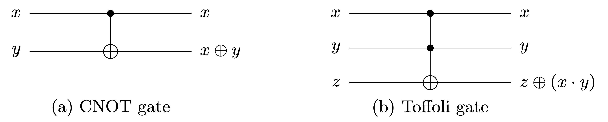
3. Quantum Implementation of BIKE
The CNOT gate replaces classical XOR operation
The Toffoli gate replaces classical AND operation

Slide 10
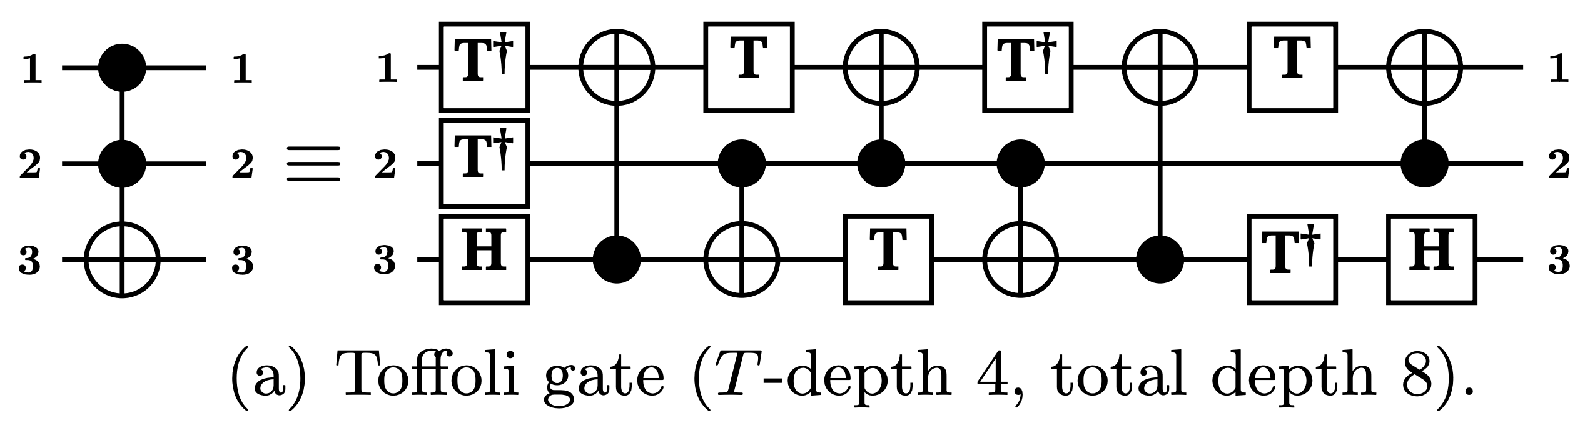
3. Quantum Implementation of BIKE
Actually, the Toffoli gates are more complex than other quantum gates
We should reduce the use of Toffoli gates (depth).
*
*
M. Amy, D. Maslov, M. Mosca, M. Roetteler, and M. Roetteler, “A meet- in-the-middle algorithm for fast synthesis of depth-optimal quantum circuits,”

Slide 11



3. Quantum Implementation of BIKE
1) Key Generation
Public key ($h=h_{1}h_{0}^{−1}$) is main.
(1) $h_{1}$ $×$ $h_{0}^{−1}$
→ Inverse of $h_{0}$
Itoh-Tsuji Inversion Algorithm
Ex) $α^{−1}=α^{254}={((α∙α^{2})∙{{(α∙α}^{2})}^{4}∙{{(α∙α}^{2})}^{16}∙α^{64})}^{2}$
Multiplication + Squaring (multiplication is much more expensive !!)

Slide 12
3. Quantum Implementation of BIKE
We adopt quantum Karatsuba multiplication [1] by Jang et al.’s work.
Can reduce the number of Toffoli gates.
Provide the least depth implementation of quantum multiplication.
[1] K. Jang, W. Kim, S. Lim, Y. Kang, Y. Yan and H. Seo, “Optimized Implementation of Quantum Binary Field Multiplication with Toffoli Depth One”, International Conference on Information Security Applications, 2022.

Slide 13
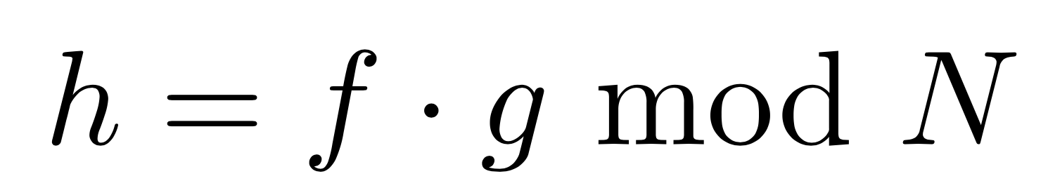
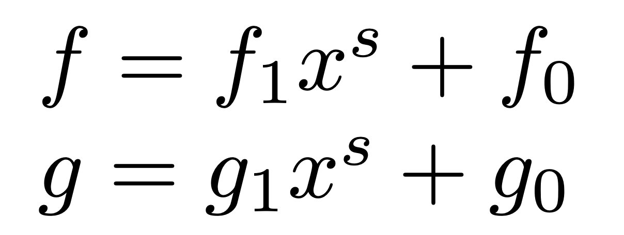
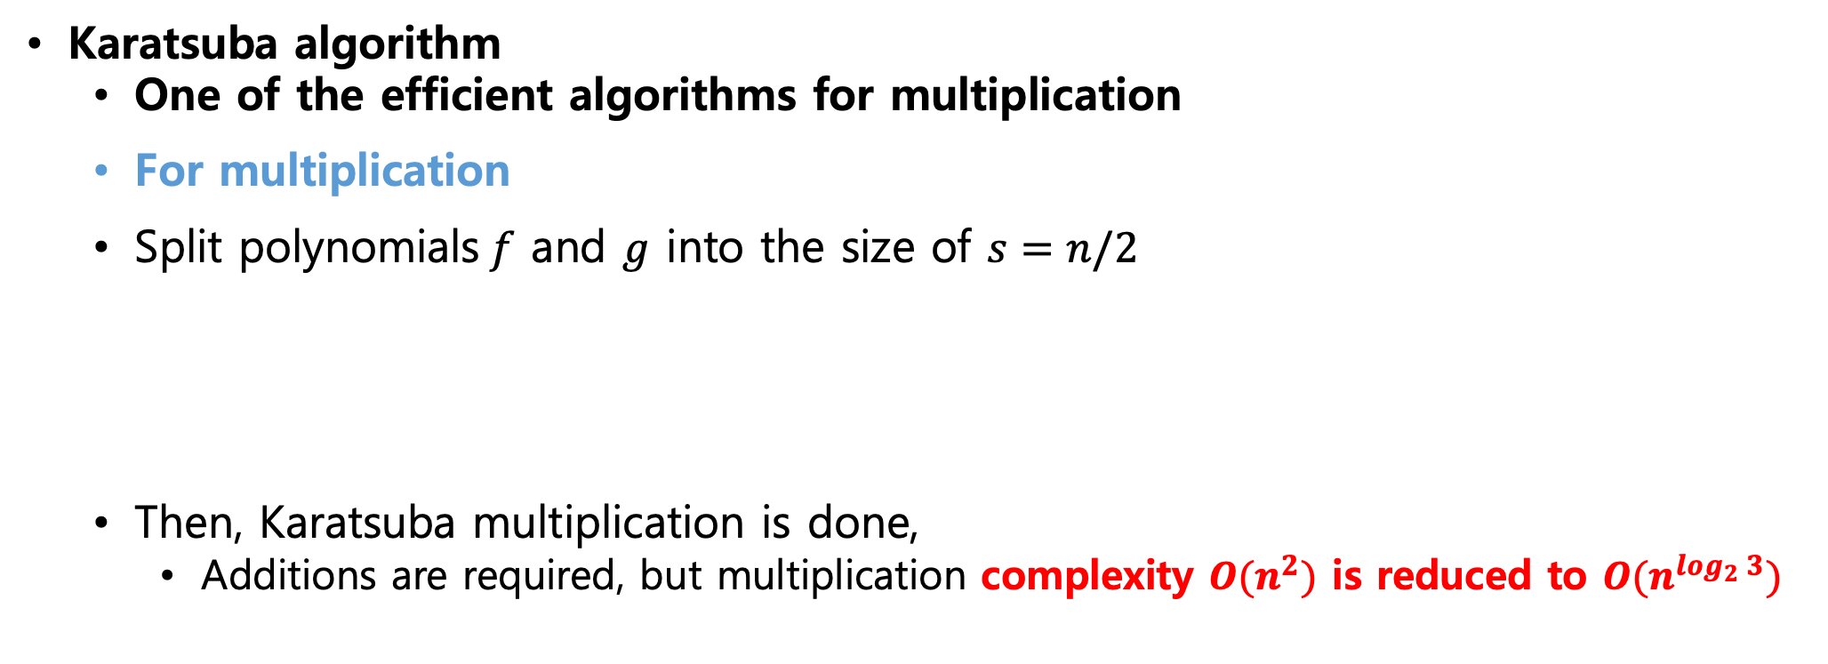
3. Quantum Implementation of BIKE
Karatsuba algorithm
One of the efficient algorithms for multiplication
For multiplication
Split polynomials$f$ and $g$ into the size of $s=n/2$
Then, Karatsuba multiplication is done,
Additions are required, but multiplication complexity $O(n^{2})$ is reduced to ${O(n}^{\log_{2}{3}})$

Slide 14
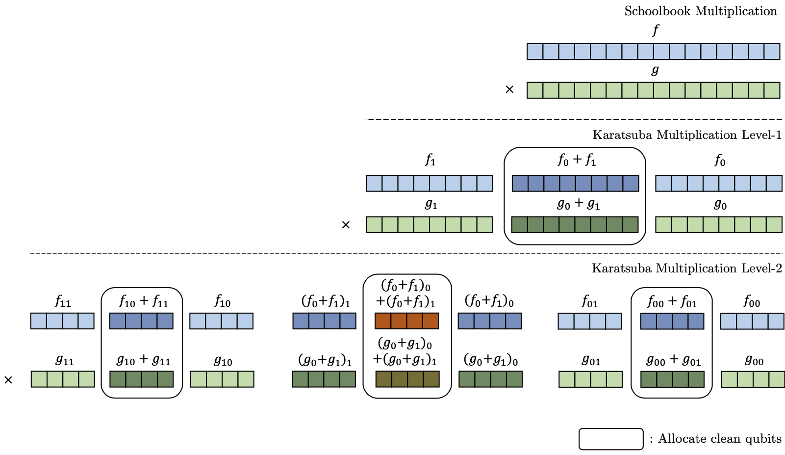
3. Quantum Implementation of BIKE
There are many quantum multiplications using the Karatsuba algorithm.
Among them, this method [1] provides the lowest depth, but high number of qubits.
[1] K. Jang, W. Kim, S. Lim, Y. Kang, Y. Yan and H. Seo, “Optimized Implementation of Quantum Binary Field Multiplication with Toffoli Depth One”, International Conference on Information Security Applications, 2022.

Slide 15

3. Quantum Implementation of BIKE
1) Key Generation
Public key ($h=h_{1}h_{0}^{−1}$) is main.
(1) $h_{1}$ $×$ $h_{0}^{−1}$
→ Inverse of $h_{0}$
Quantum Inversion (based on the Itoh-Tsujii algorithm).
Multiplication + Squaring
→ The Karatsuba method is adopted in this work.
(2) $h_{1}$ $×$ $h_{0}^{−1}$
The Karatsuba multiplication is used once more.

Slide 16


3. Quantum Implementation of BIKE
2) Encapsulation
Ciphertext $c_{0} =e_{0}+e_{1}h$ is main.
(1) $e_{1}h$
Same Karatsuba multiplication is used.
(2) $e_{0}+e_{1}h$
Modular addition (XOR-ing) is implemented by using only CNOT gates.
There is no optimization point for quantum addition (only for binary field).

Slide 17
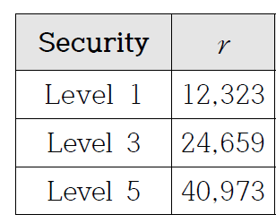
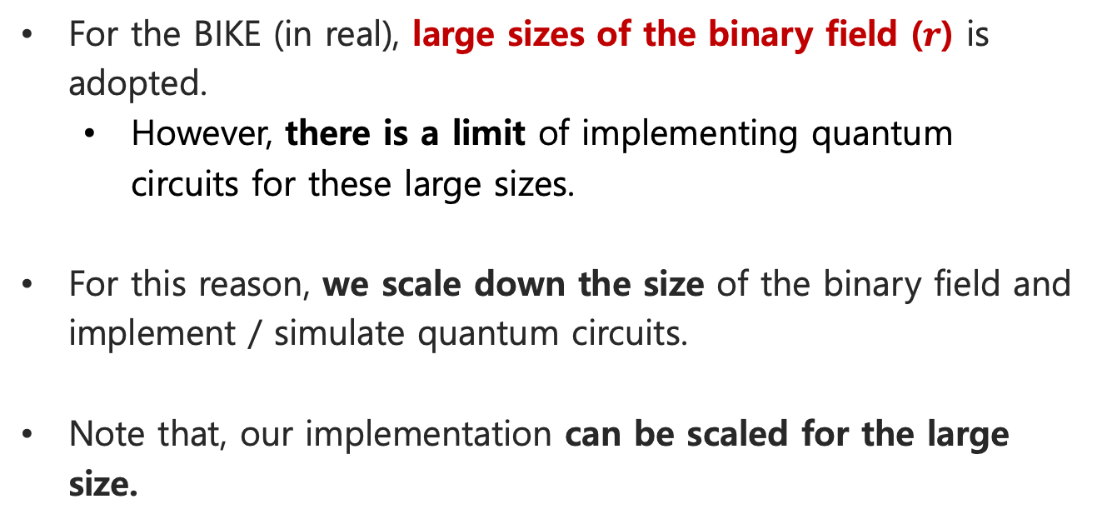
4. Evaluation
In this work, we implement quantum circuits of Key generation and Encapsulation (except for Decapsulation, maybe future work).
Quantum programming tool ‘ProjectQ’ is used for our work.
For the BIKE (in real), large sizes of the binary field ($r$) is adopted.
However, there is a limit of implementing quantum circuits for these large sizes.
For this reason, we scale down the size of the binary field and implement / simulate quantum circuits.
Note that, our implementation can be scaled for the large size.

Slide 18
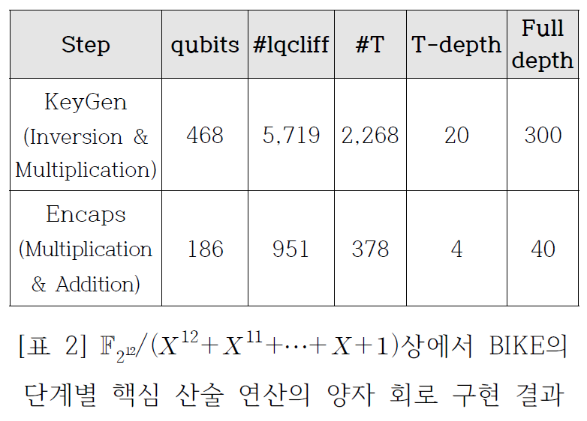
4. Evaluation
We can see that most of the quantum resources are used for KeyGen.
Because of the quantum inversion (a total of 5 multiplications).
For encapsulation, relatively less quantum resources are used.
Since the quantum multiplication is performed only once.
KeyGen →
Encapsulation →

Slide 19
4. Conclusion
In this paper, we implement the quantum circuit of core operations for BIKE (i.e., KeyGen and Encapsulation).
Based on the implemented quantum circuits, we estimate the required quantum resources.
Actually, current implementation result can not provide the practical quantum cryptanalysis.
We believe/hope that the quantum circuits presented in this paper (fundamental) can be used for the future research.

Slide 20
Thank you

